Slide 1
Friday, August 18, 2017
Write In Your Agenda:
Write In Your Monitoring Log:
CW:
Mystery Waters Activity
Determining Density
HW:
Study for Metric System Quiz on Monday 8/21/17!
Have Monitoring Log signed!
Response to Warm-Up:
How many steps are there in the Scientific Method?
You will need:
Pencil
Agenda
Monitoring Log

Slide 2
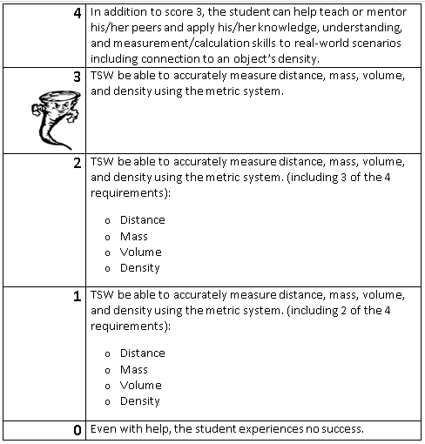
Learning Goal and Scale
TSW be able to accurately measure distance, mass, volume, and density using the metric system.

